Slide 1

College ErP sYSTEM
ANDROID APPLICATION

Slide 2

>Team members
Axis institute of higher education
Pratham Awasthi.
Mohammad Naim.
Raj Devvanshi.
>Enrollment number
22015001073
22015001043
22015001085

Slide 3
1. InTRODUCTION
4.5 student registration screen
1.1 PROBLEM
4.6 read & edit college details screen
1.2 SOLUTION
4.7 students list screen
4.8 Edit student details screen
1.3 OBJECTIVE
4.9 semester & select option screen
2. Features of app
4.10 enter marks
4.11 faculty registration screen
2.1 list of features
4.12 faculty list screen
3. technologies
4.13 faculty enter salary screen
3.1 frontend
5. Challenges
3.2 backend
6. conclusion
3.3 programming language
3.4 tools
7. Thank you
4. Screenshots
4.1 login & signup screen
4.2 create account screen
4.3 home screen
4.4 drawer screen

Slide 4

1.1 Problem
Manual Record-Keeping
Data Accessibility Issues
Lack of Offline Solutions
Colleges often rely on manual methods to manage student and faculty data, which is time-consuming and error-prone.
Lack of a centralized platform for securely storing and retrieving college data.
Difficulties in accessing data when needed due to scattered or unorganized storage methods.
Many existing systems depend on internet connectivity, which may not always be reliable or available, especially in rural areas.
There is a need for an application that works seamlessly without requiring internet access.
Administrative Challenges
The absence of a proper system increases the workload for administrators in handling tasks like adding, updating, or deleting student and faculty records.

Slide 5
1.2 Solution
Digital Data Management
Centralized Data Management
The app replaces manual record-keeping with a fully offline database, ensuring fast and error-free data management.
The app consolidates all college-related data (students, faculty, and college details) into a single, easily accessible offline database.
Offline Database Integration
Easy to use
The app is built with a fully offline database that stores all college, student, and faculty data locally on the device, eliminating the need for internet access
The app automates tasks such as managing student and faculty details, eliminating the need for manual record-keeping.

Slide 6

1.3 objective
Simplify Data Management
To create an efficient system for managing student and faculty data by replacing manual methods with an automated digital solution.
Provide Offline Functionality
To develop an app that works seamlessly without internet connectivity, ensuring accessibility in remote or rural areas.
Enhance Administrative Efficiency
To reduce the workload on administrators by automating CRUD operations and simplifying routine tasks.

Slide 7

2.1 list of features
1. Login and Signup System ​
Secure authentication for administrators, faculty, and students.
2. Offline Data Storage ​
All data is stored locally, ensuring functionality without internet access.
3. CRUD Operations
Create, Read, Update, and Delete student and faculty records efficiently.
4. College Details Management
Store and manage essential college information in one place.
5. User-Friendly Interface
Built using Flutter framework for a smooth and intuitive user experience.
6. Role-Based Access
Separate interfaces and functionality for administrators, faculty, and students.

Slide 8

3.1 frontend
1. Flutter Framework for UI Design:
Leveraged Flutter’s pre-built widgets like TextField, ListView, Button and custom widgets to craft a sleek and modern interface.
2. Simple Navigation:
Leveraged Flutter’s pre-built widgets like TextField, ListView, Button and custom widgets to craft a sleek and modern interface.
3. Dart Programming for UX Logic:
Used Dart to create seamless workflows like login/signup, CRUD operations, and error handling to enhance usability.
4. Interactive Elements:
Added features like buttons with animations, progress indicators, and tooltips to guide users through actions.

Slide 9

3.2 backend
1. Database
SQLite is used for local, offline data storage. It provides a lightweight, efficient, and serverless database that ensures seamless performance even without an internet connection.
​
2. CRUD Operations​
​
Create, Read, Update, and Delete (CRUD) operations are implemented to allow administrators to manage student and faculty data.
​
3. Offline Storage and Sync​
​
Since the app operates offline, all data is stored locally, allowing users to manage and access records even in areas with poor or no internet connectivity.
​
4. Data Security​
​SQLite ensures data security by using encryption (if implemented) to prevent unauthorized access to sensitive data stored in the local database.

Slide 10

3.3 programming language
Overview of Dart programming language ​
Dart is the primary programming language used in the app development. It is an object-oriented language developed by Google, specifically optimized for building high-performance, cross-platform mobile applications.
Why Dart? ​
Integration with Flutter: Dart is the backbone of the Flutter framework, which is used to build the UI and handle business logic in the app. It offers a rich set of libraries and tools that simplify app development. Dart allows hot reload, meaning that developers can see changes in real-time, making the development process faster and more efficient.
Key Features of Dart Used ​
Asynchronous Programming: Dart supports async/await and Futures, enabling the app to handle tasks like fetching data, reading from files, and database queries without blocking the UI thread. This ensures smooth performance.
Advantages of Dart in App Development​
High Performance: Dart is compiled ahead of time (AOT), ensuring fast startup times and optimal runtime performance.

Slide 11
3.4 tools
1. Android Studio
3. SQLite database​
Android Studio is the primary integrated development environment (IDE) used for building the College ERP Android app. ​
SQLite is used as the local, offline database for storing student and faculty data, college details, and other important information.
2. Flutter SDK
4. plugins​
Flutter SDK includes everything needed to build apps, from libraries and tools to compilers and documentation. It simplifies the process of building apps with modern, reactive frameworks.
The sqflite plugin is used for integrating SQLite into the Flutter app. The path_provider plugin helps in locating commonly used directories on the device, like the documents directory or the temporary directory.

Slide 12
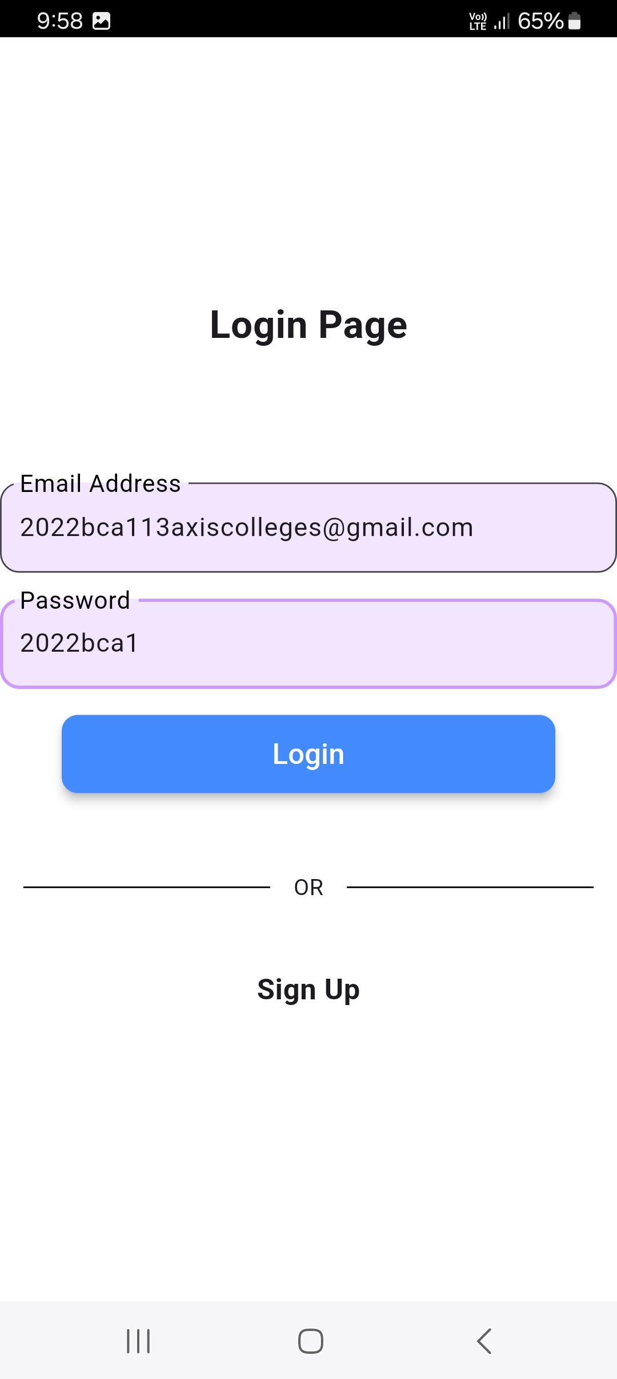
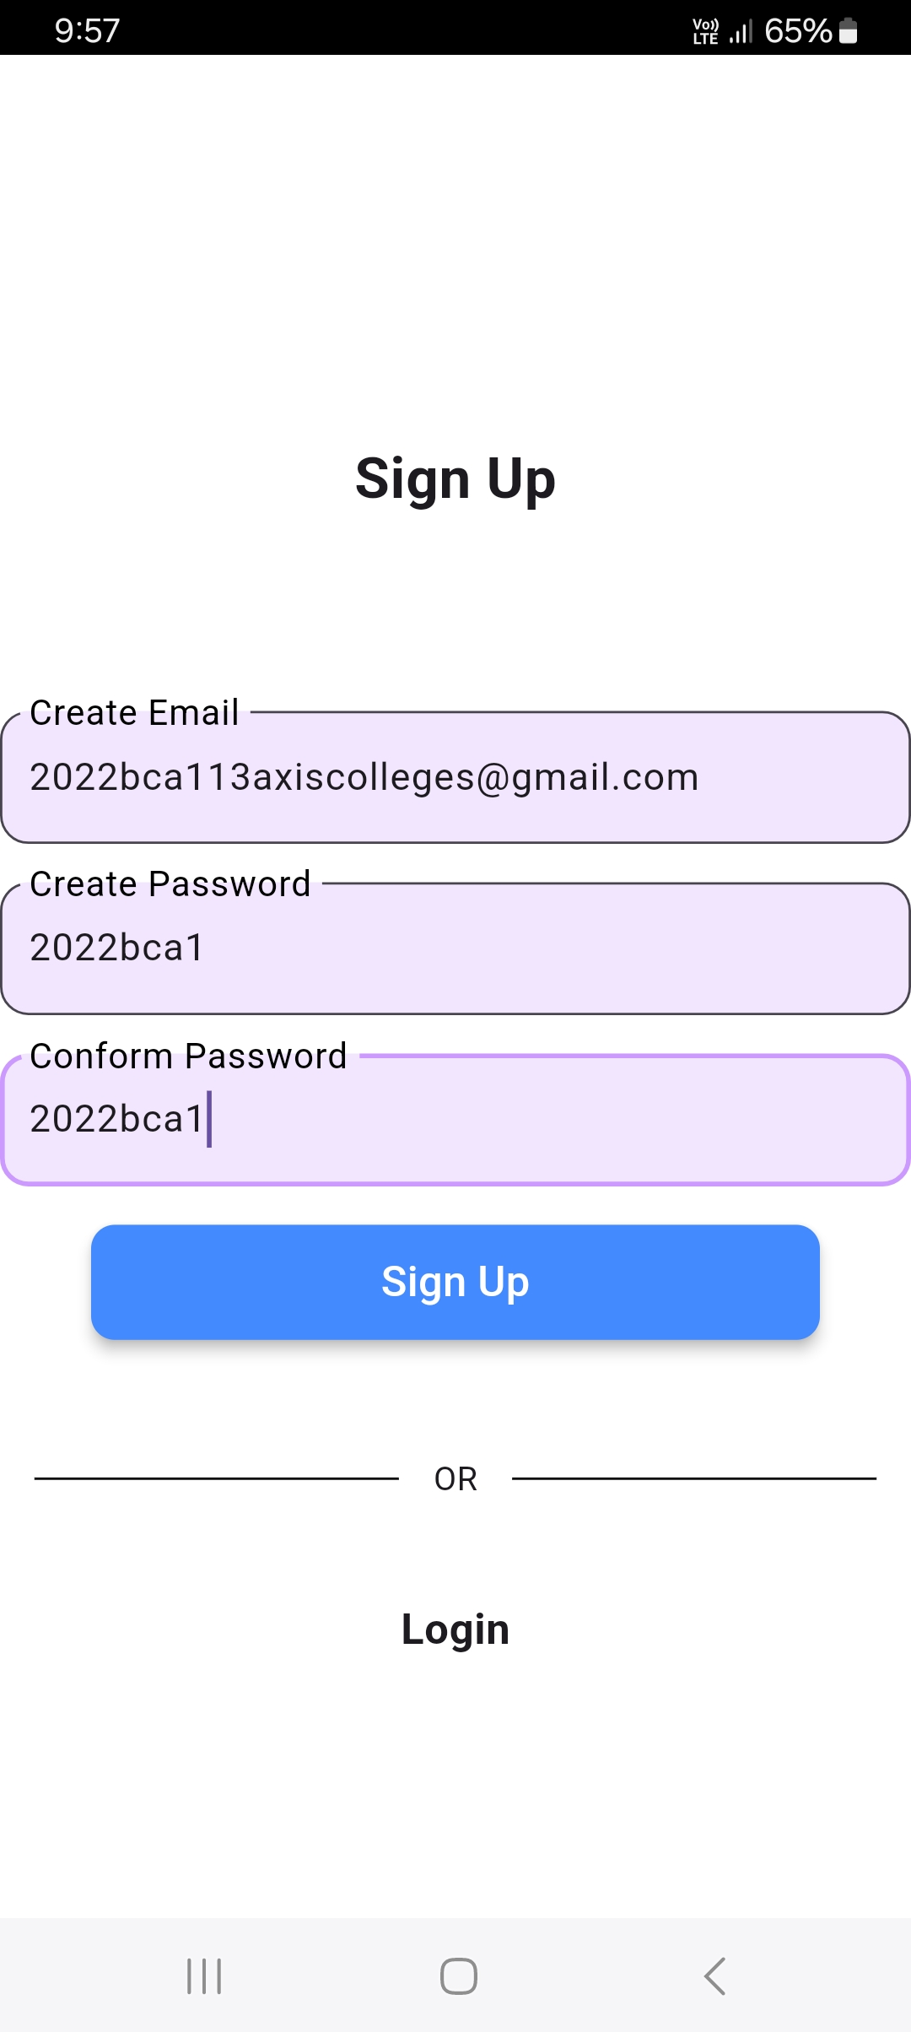
4.1 login & signup screen

Slide 13
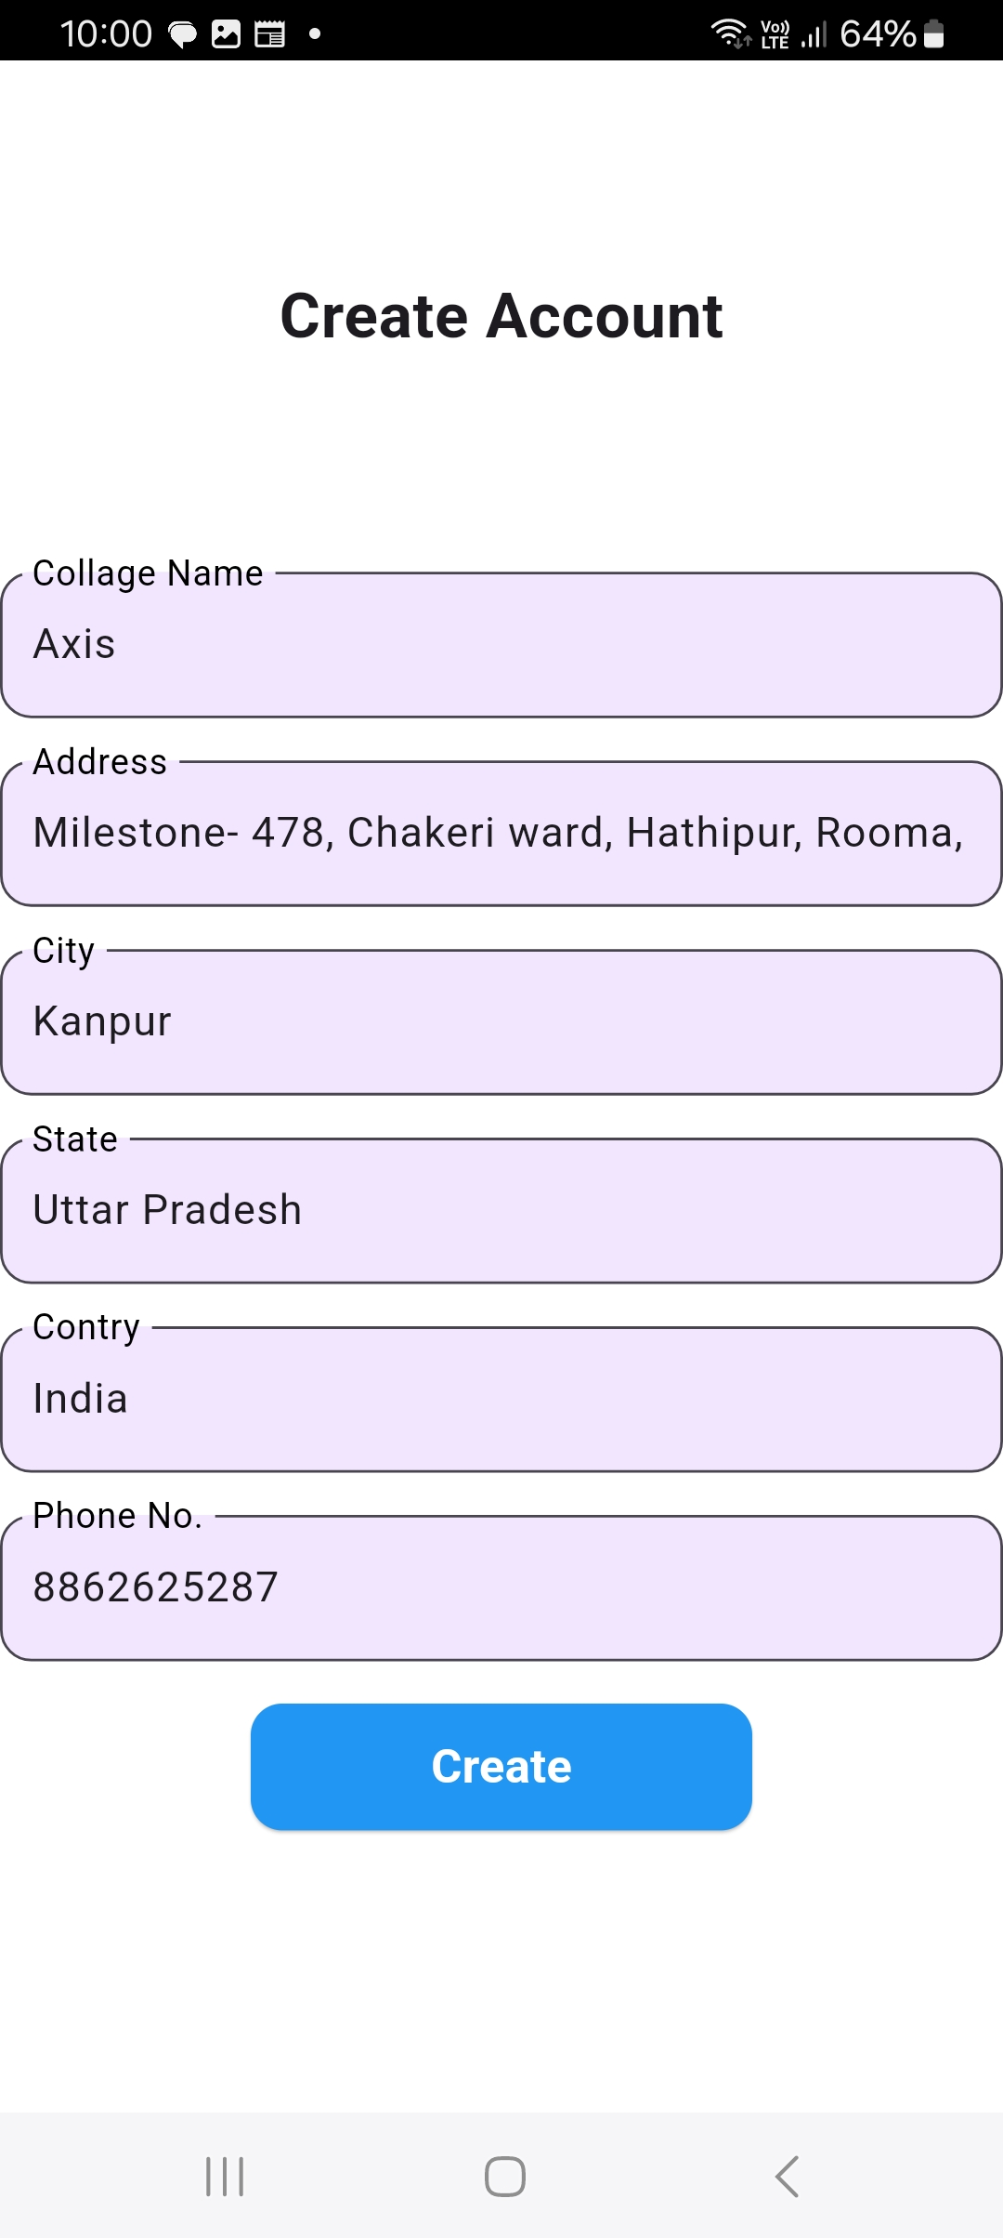
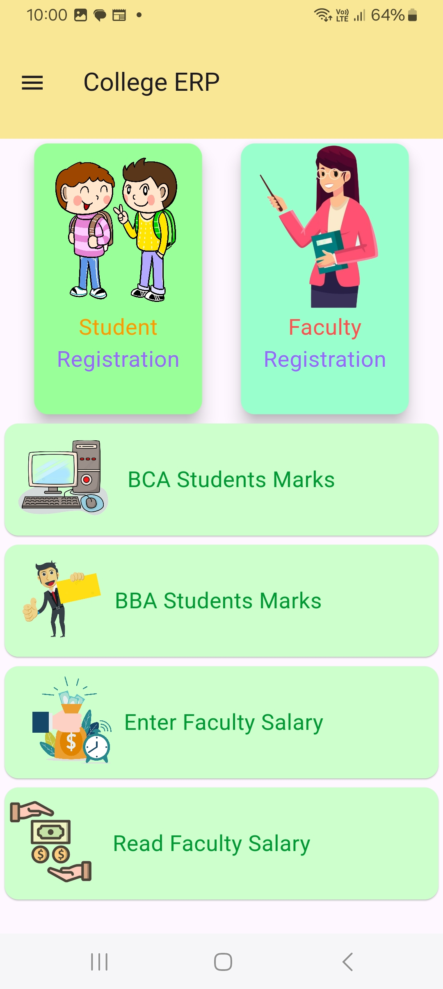
4.2 create account screen
4.3 home screen

Slide 14
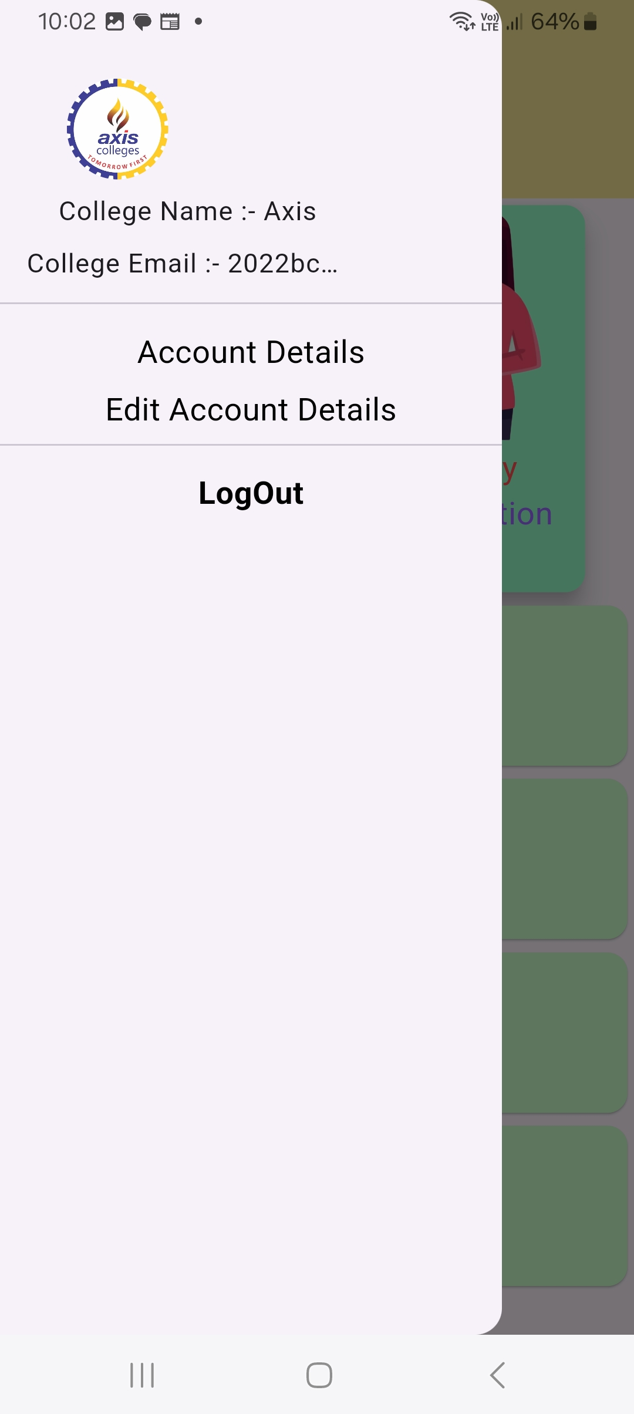
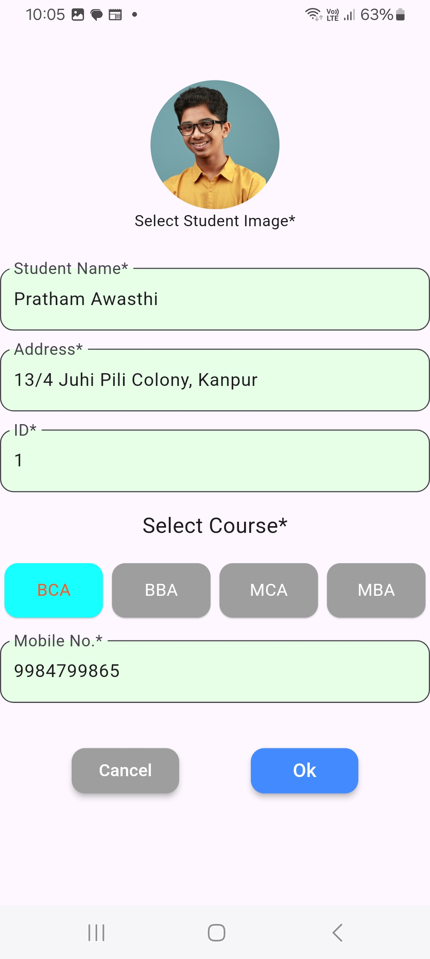
4.4 drawer screen
4.5 student registration screen

Slide 15
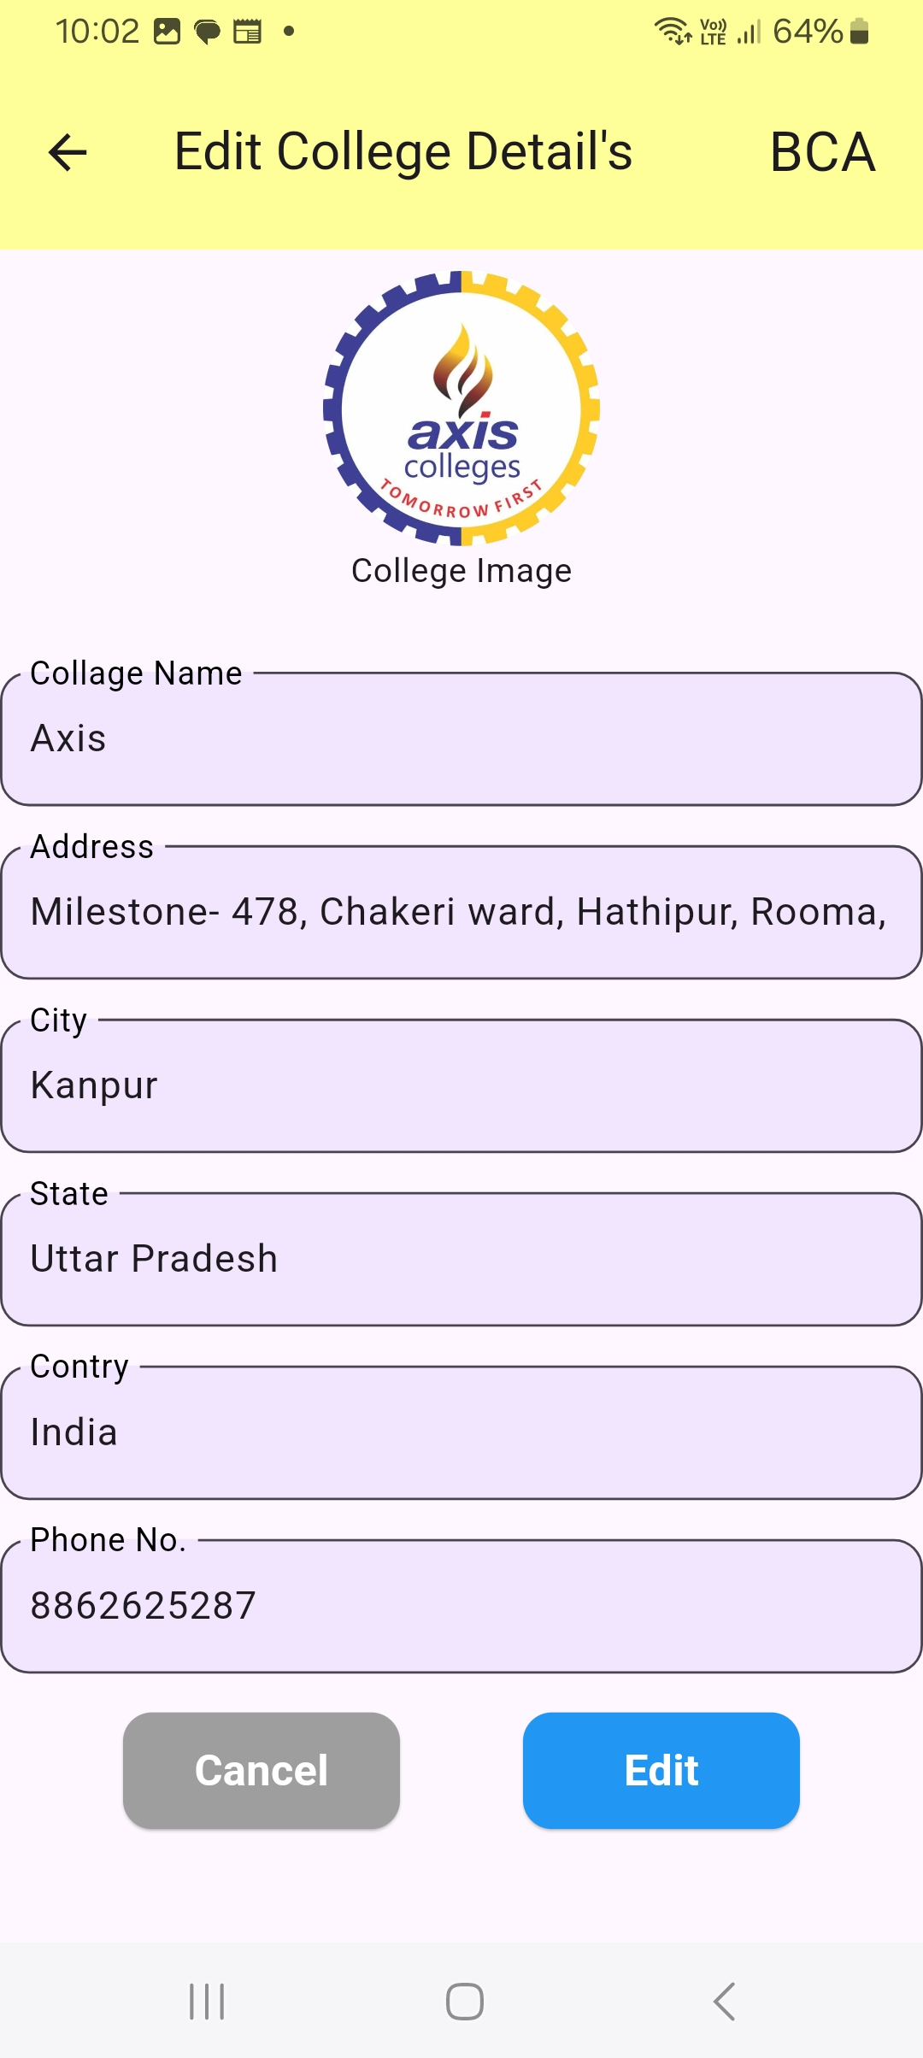
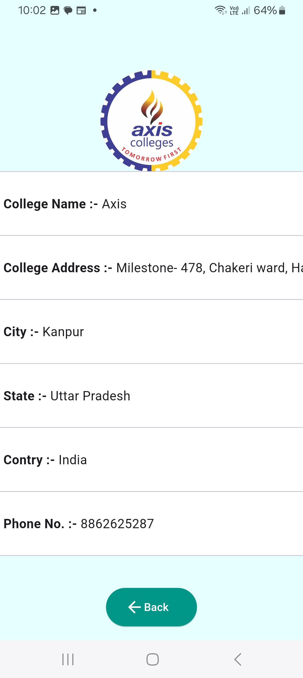
4.6 read & edit college details screen

Slide 16
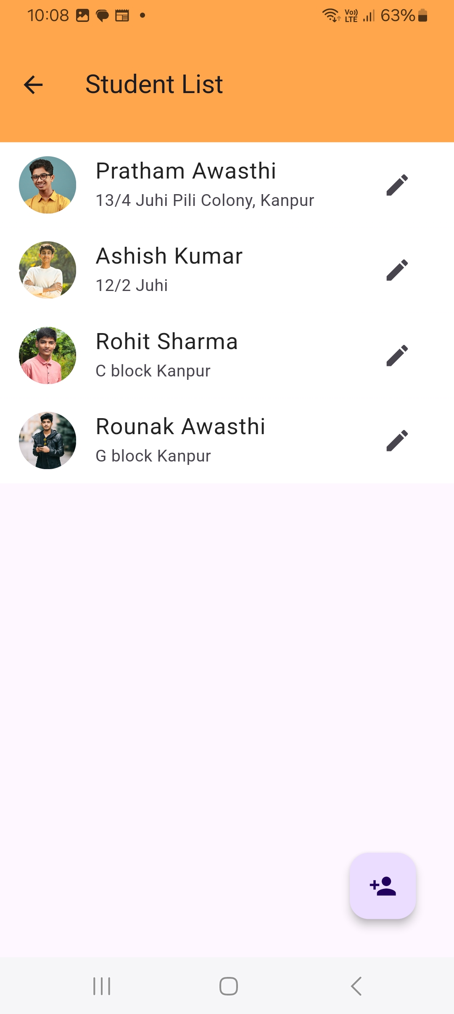
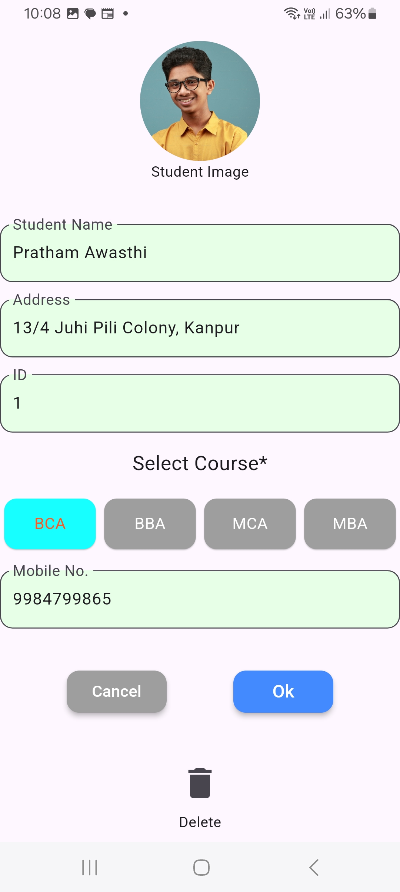
4.7 students list screen
4.8 Edit student details screen

Slide 17
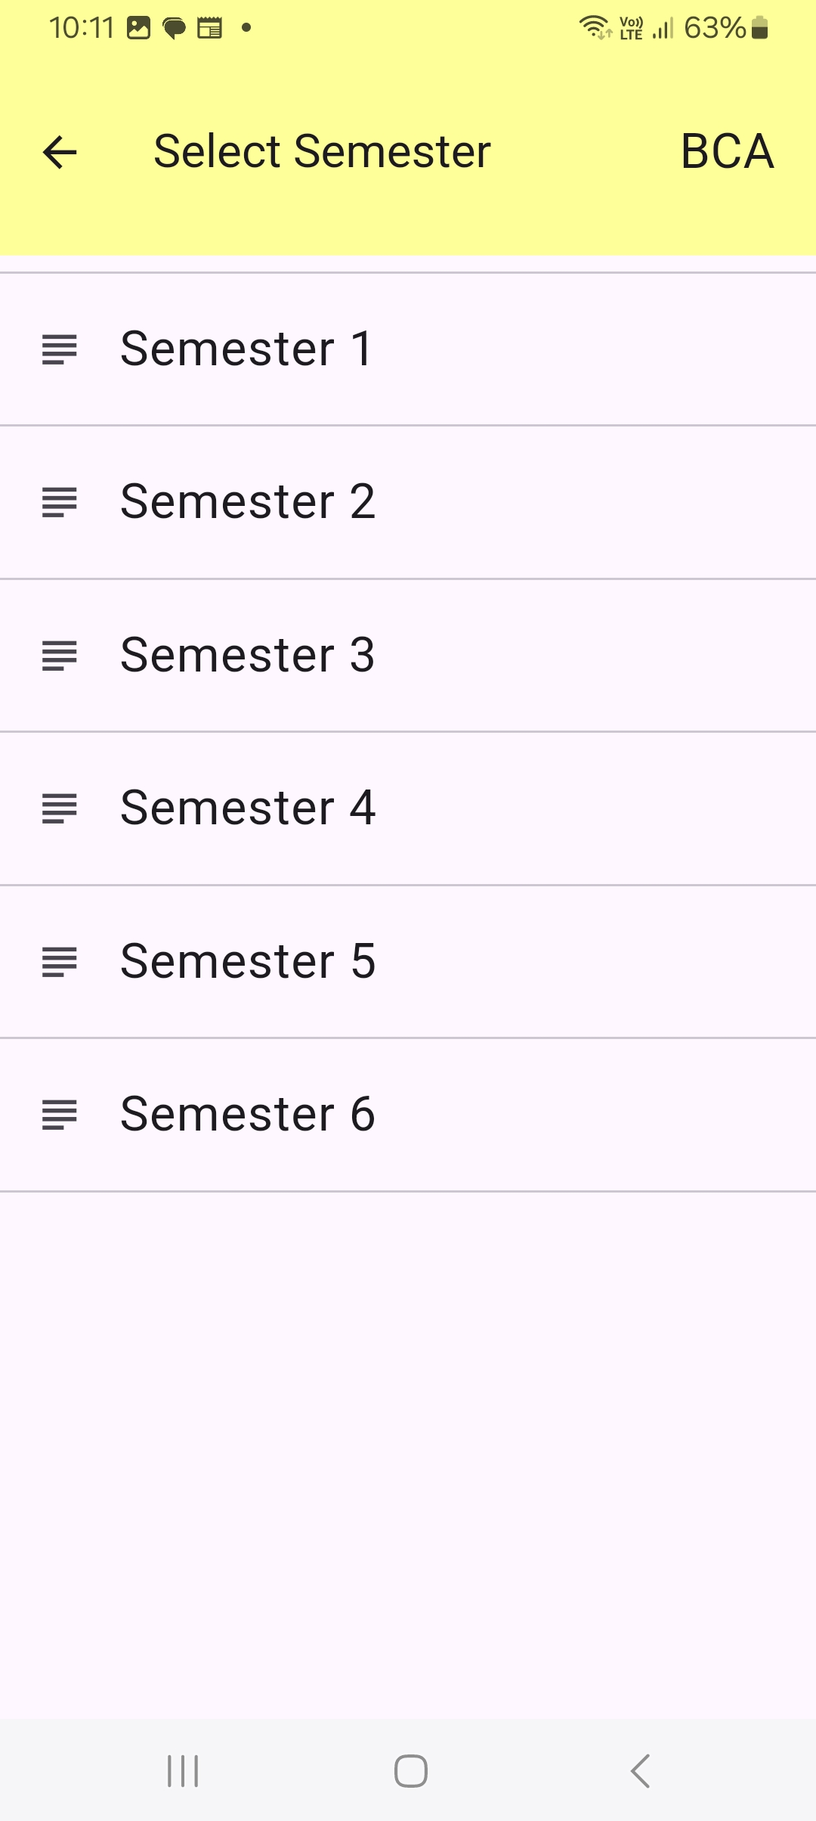
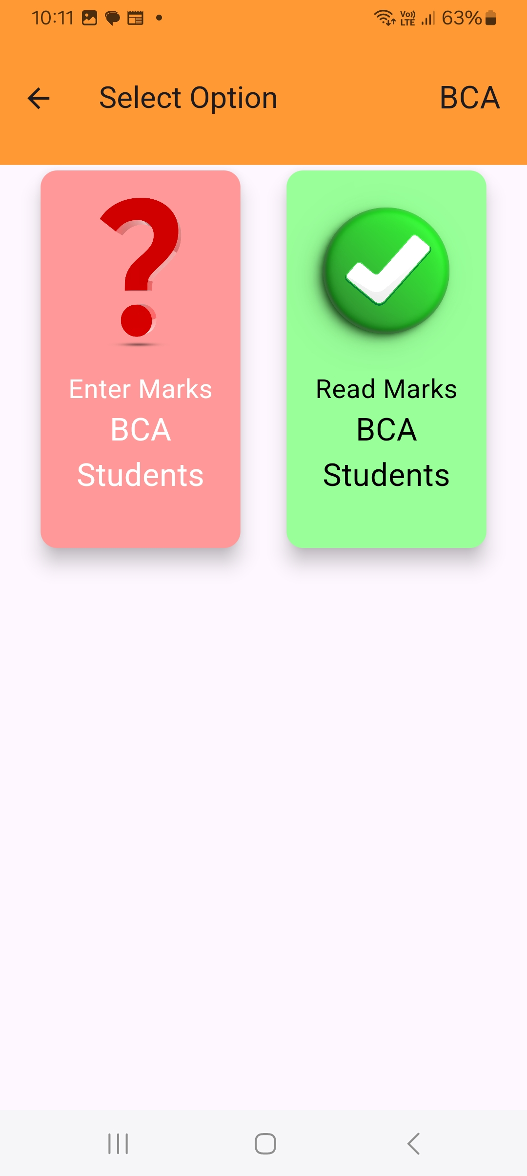
4.9 semester & select option screen

Slide 18
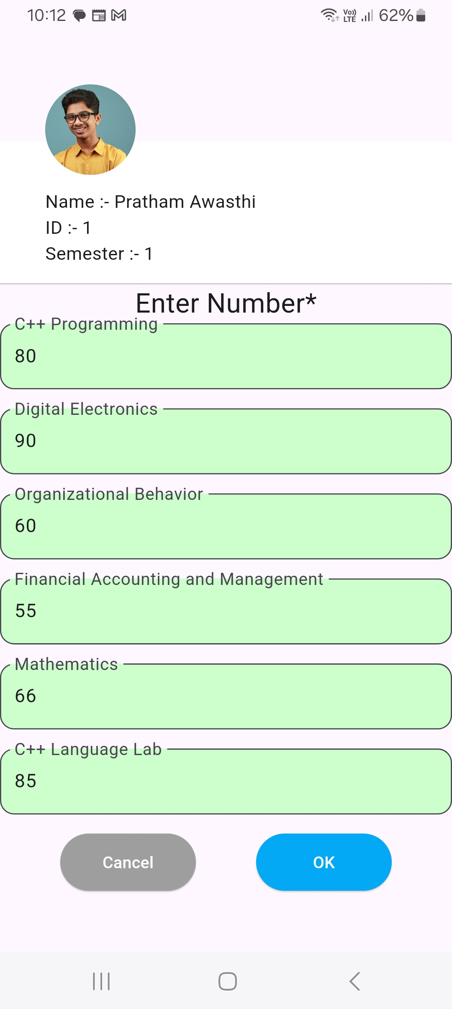
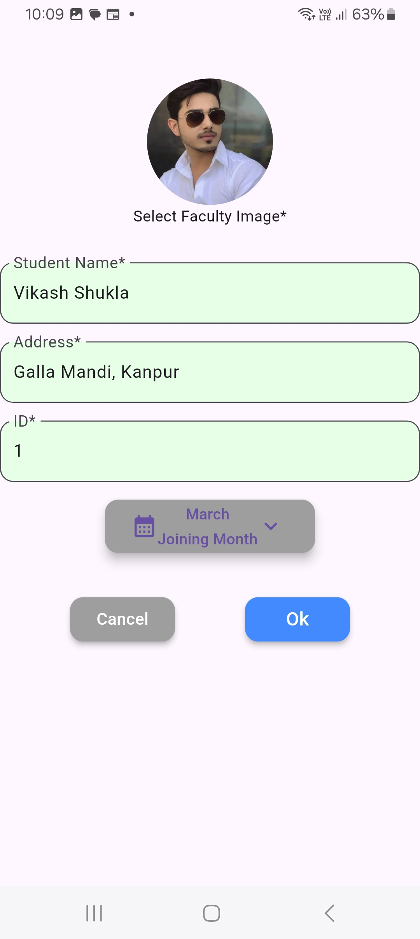
4.10 enter mark
4.11 faculty registration screen

Slide 19
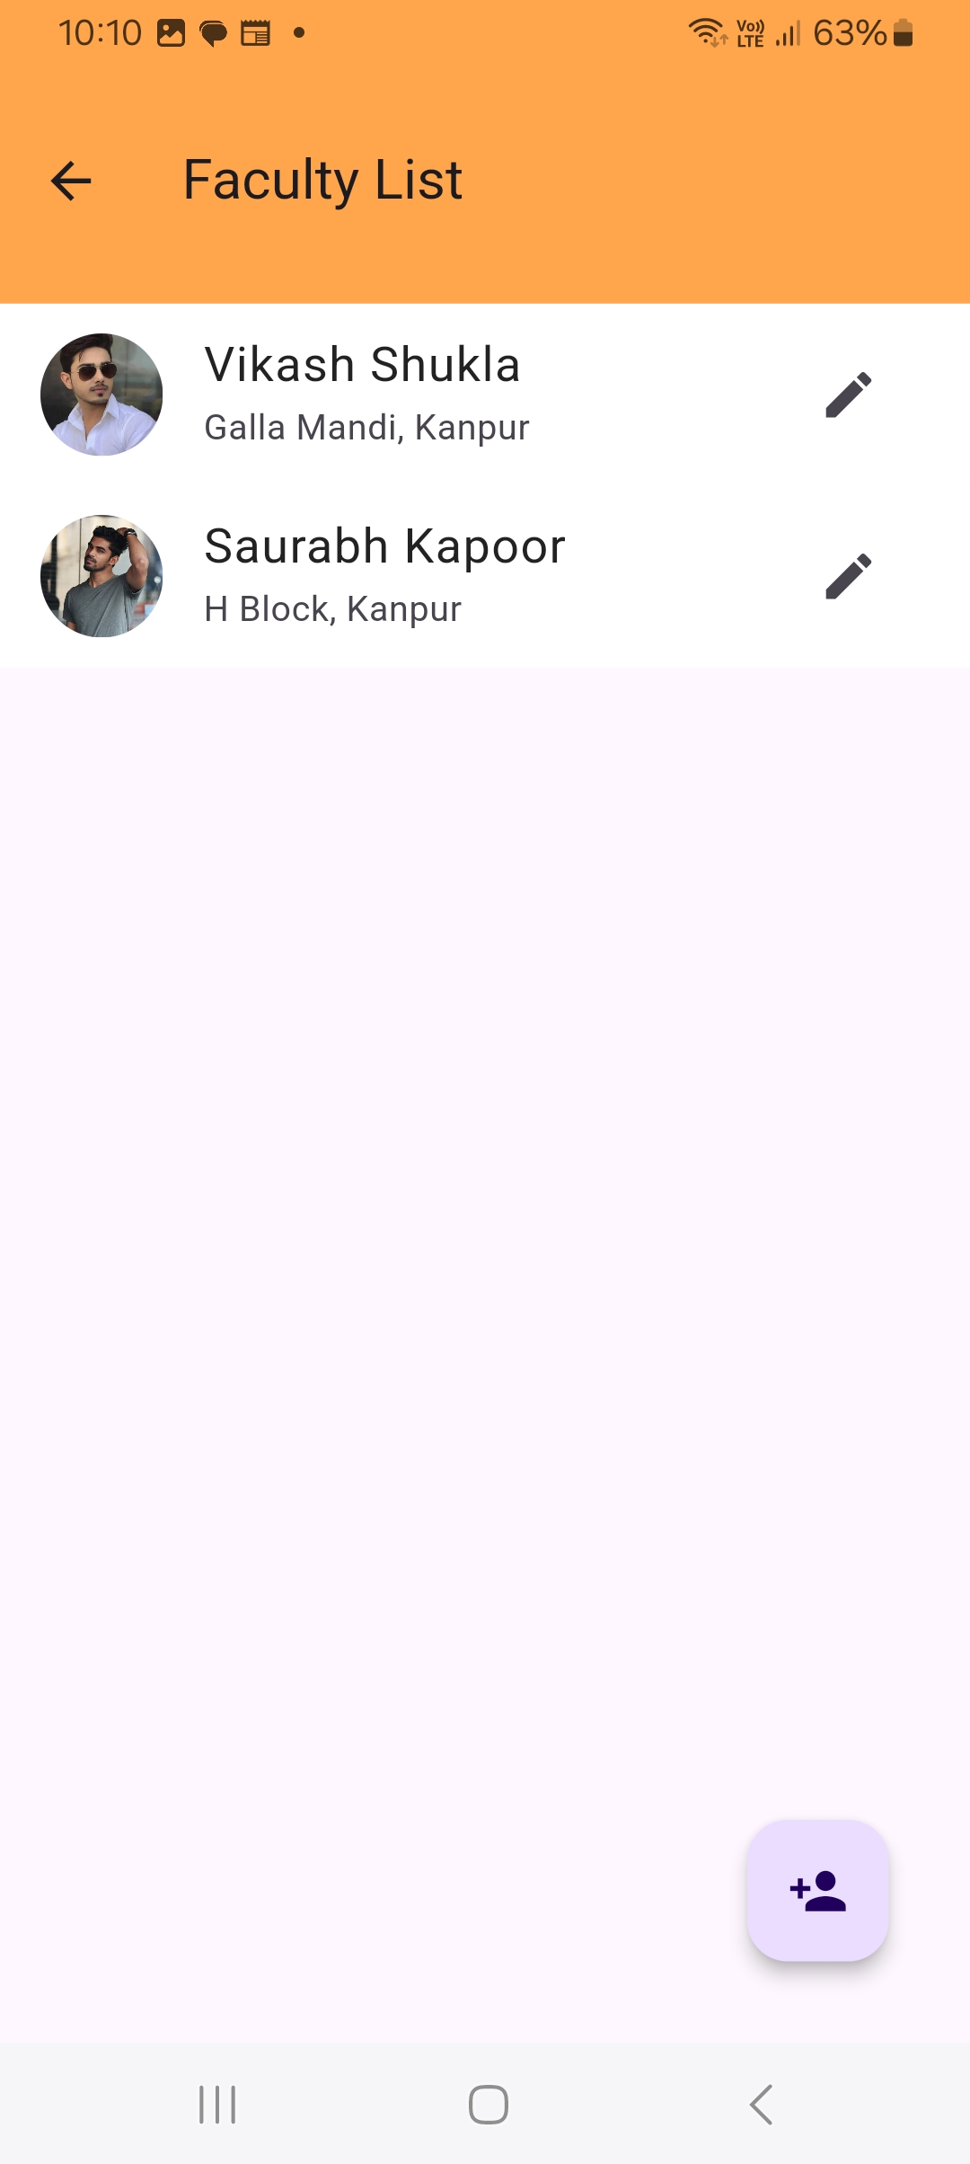
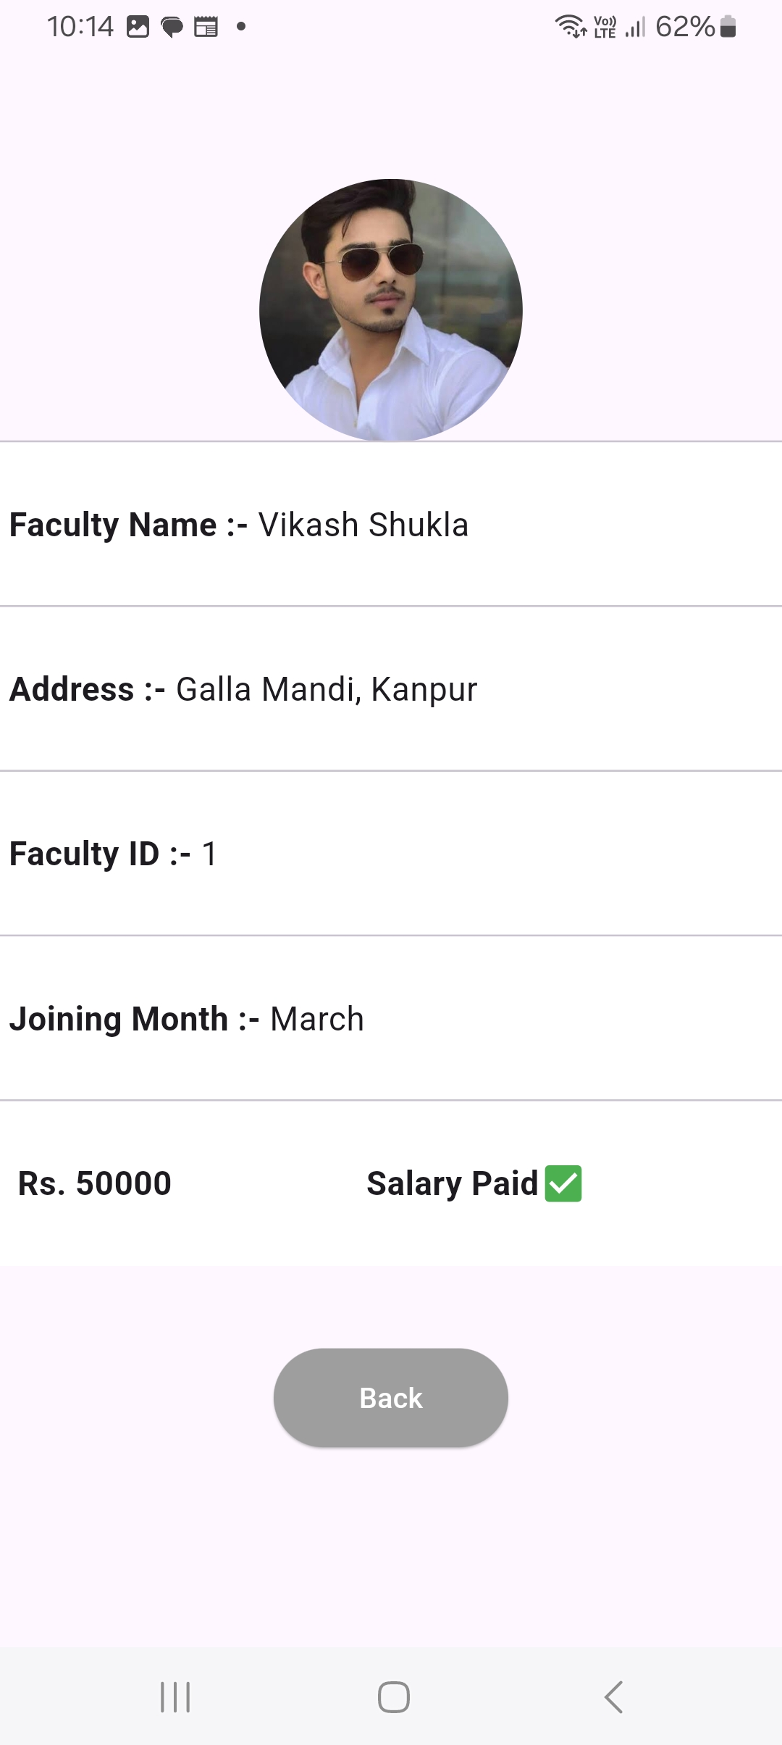
4.12 faculty list screen
4.13 faculty enter salary screen

Slide 20
5. Challenges
2. Managing App Performance with Limited Device Resources
1. UI Consistency Across Devices
Complex CRUD Operations with Limited Resources
Problem: Ensuring UI consistency on different devices with varying screen sizes.
Solution: Used Flutter's responsive design features like MediaQuery and LayoutBuilder.
Problem: Ensuring smooth app performance with limited device resources (memory and CPU).
Solution: Optimized memory usage and implemented efficient querying and data loading strategies.
Problem: Performing complex CRUD operations with multiple tables and relationships in SQLite.
Solution: Designed optimized database schemas and relationships, simplifying CRUD operations.

Slide 21
6. conclusion
The College ERP Android app successfully addresses the challenges faced by colleges in managing student, faculty, and college data. By utilizing Flutter for the frontend and SQLite for offline data storage, the app ensures smooth and efficient data management even without an internet connection. The app offers a seamless user experience with a responsive UI and robust backend functionality, allowing for easy access to data and management through CRUD operations. Data security is prioritized through encryption, ensuring that sensitive information is well protected. Despite challenges such as offline synchronization and managing large datasets, the app provides a reliable, efficient solution for college administration.
Overall, this app simplifies administrative tasks, improves data accessibility, and enhances the overall efficiency of college operations, making it a valuable tool for both students and faculty.
COLLEGE ERP SYSTEM

Slide 22

Thank you
Thank you for your time and attention. This project wouldn’t have been possible without the support and hard work of my team members. I, along with Pratham Awasthi and Mohd Naim, Raj Devvanshi sincerely appreciate the opportunity to present this College ERP app.

